Slide 1
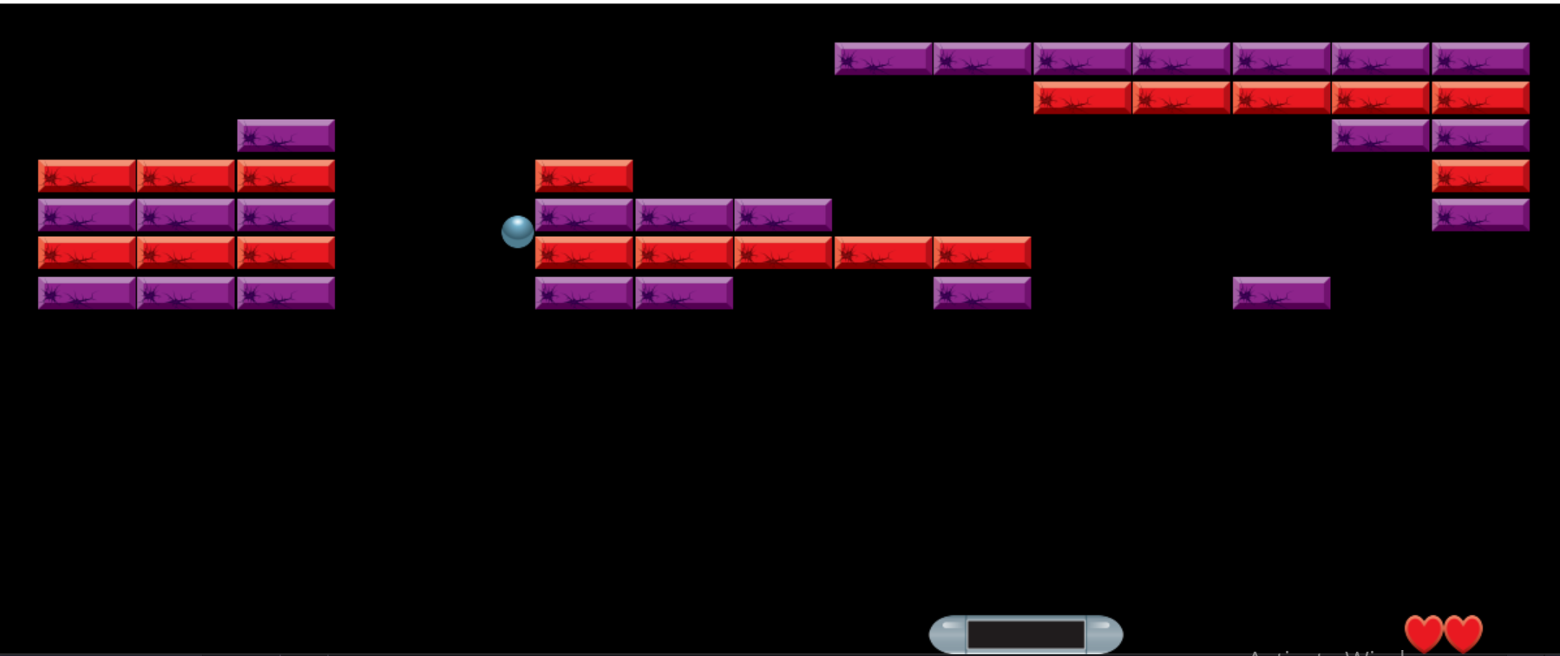
BRICK BREAKER GAME
Group members:
Sajjad Ahmad
M. Huzaifa Naeem

Slide 2
Motivation behind Project
Tired of boring Programs
Entertainment Value
Examples include Library Management System, Attendance Management System, etc
Developing and playing your own game has immense entertainment potential.

Slide 3

Project Overview
Brick Breaker Game is a single-player, widely popular platform game, which has, after its initial release in 1999, become a world-wide classic

Slide 4
Project Description
The Player must break all the tiles to win the game
The Paddle can move along horizontal to bounce the ball
01
02
Player loses a life if the ball falls down the screen
Running out of lives means “Game Over!!!”
03
04

Slide 5
Project Aims and Objectives
To employ OOP Techniques to make the coding process efficient
To learn the use of Pygame Library, in Game Development
To develop a platform game, intended for entertainment purposes

Slide 6
Project Methodology
Using Pygame Library
Screen fill, blit, flip methods useful for game development
Modules for Game Elements
Different classes to describe game elements like Bricks, Paddle, Ball, Health Bar.
Inheriting pygame.sprite Base Class
Useful for grouping similar objects like rows of bricks.
Helper Modules, containing logics like
Reflections Of Ball, Health Bar Control, Brick Rows Management

Slide 7
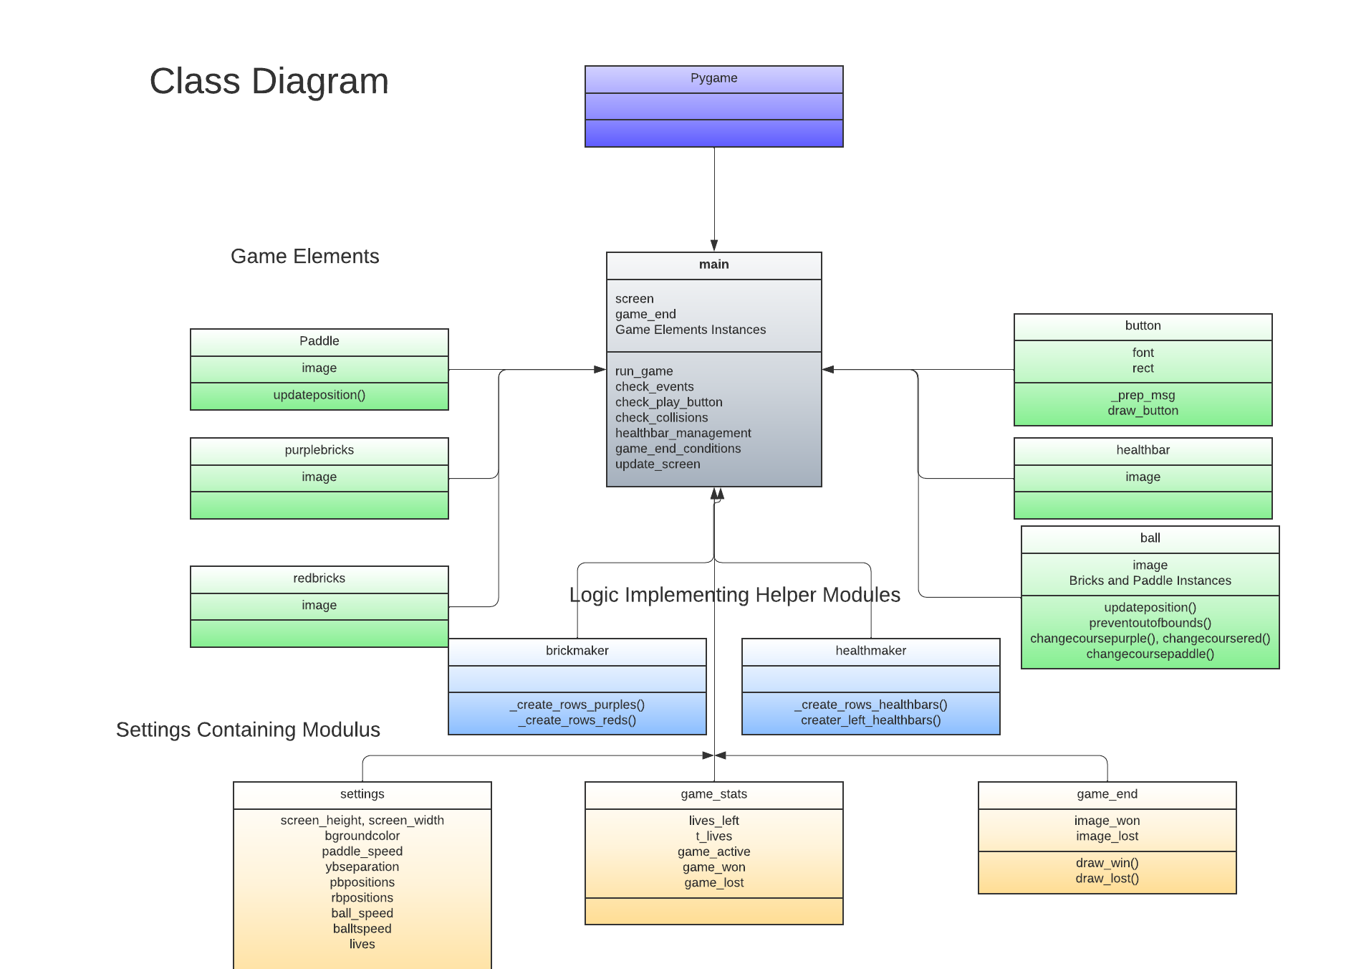

Slide 8
Project Demonstration
(drumroll please,,,,)

Slide 9
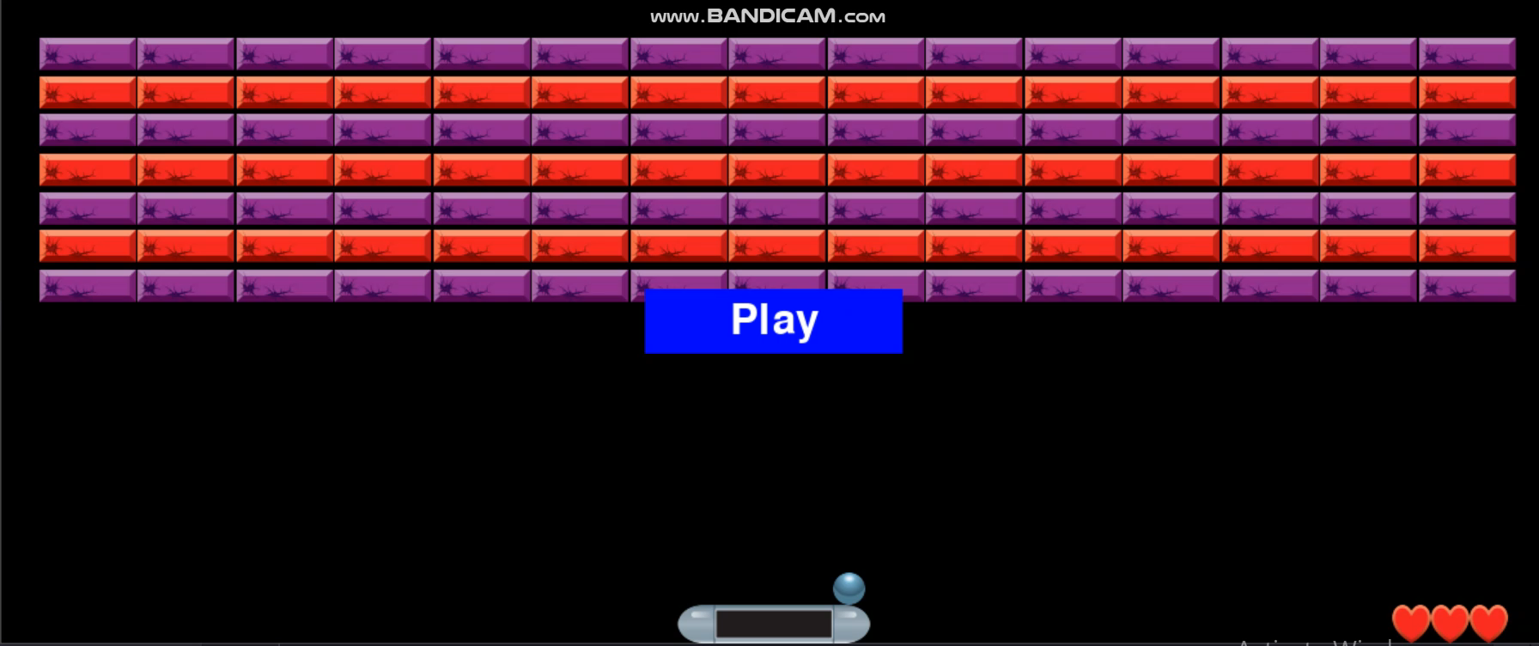

Slide 10
Future Improvements
More Levels of Playthrough
Intricate Level Designs
Scoring System
Power Ups

Slide 11
Thank You!

